Slide 1

Summer Food Service Program (SFSP) 2026 Vendor Information Session
The Child Nutrition Team
Notes:
Kiona

Slide 2
Drop your contact information in the chat!
Please leave your name, the name of the company you're representing, and an email address we can reach you at in our chat!
Following this presentation, we reach out to you to discuss partnership!
It is imperative that we have an email address and telephone number ☺
Notes:
Kiona. Chris will retrieve organization info

Slide 3

Summer Food Service Program (SFSP)
SFSP – Summer Food Service Program – is a federally funded, state-administered, Food Bank-sponsored summer program
Provide fresh, nutritious, unitized meals to kids 18 and under.
.
Notes:
Kiona

Slide 4
Why is SFSP Important?
During the summer months, while kids are not in school, they may have less access to food.
A SFSP site is a location where kids can go to safely receive a nutritious meal.
In 2024, 14.1 million children in the United States lived in households that experienced food insecurity, which is a lack of access to affordable, nutritious food.
Notes:
Kiona

Slide 5
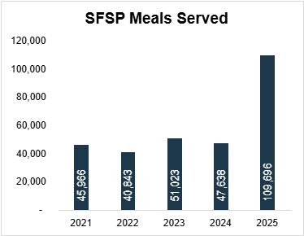
Outcomes from 2025
58 sites in 22 counties served 109,696 meals!
130% more meals than in 2024
80,042 congregate
29,654 non-congregate

Slide 6
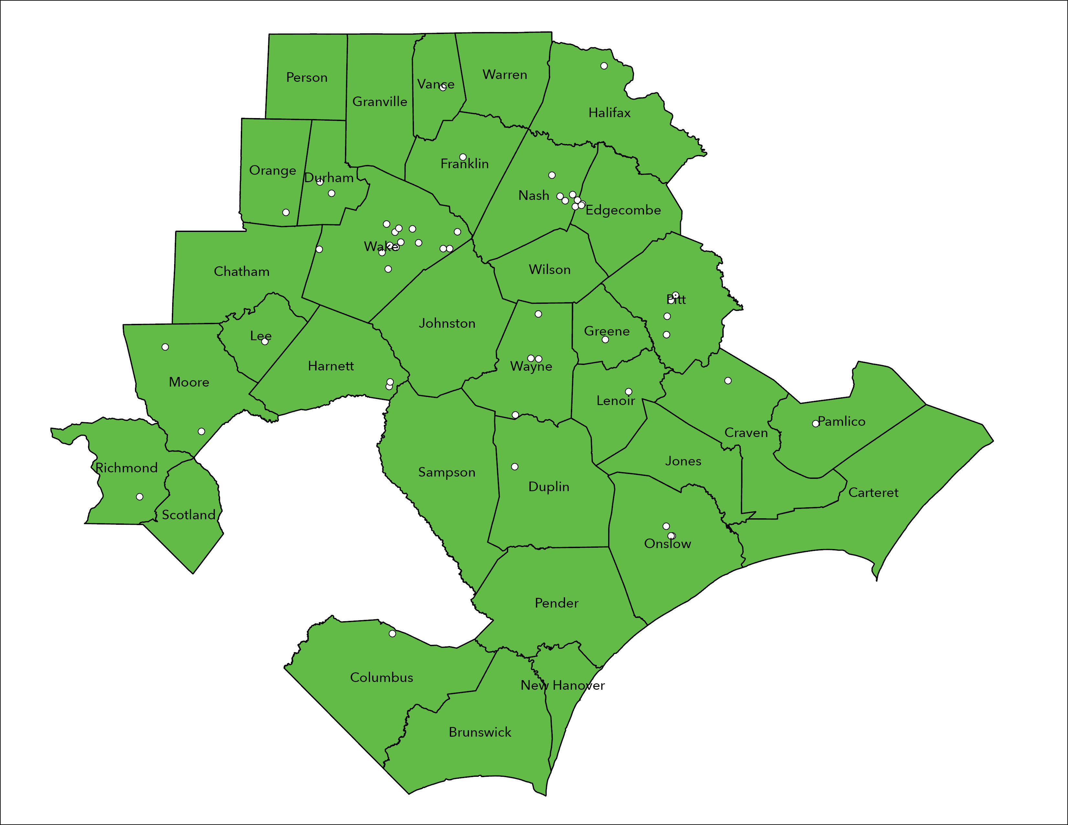
SFSP 2025 Site Locations
Notes:
2025:

Slide 7
2025 Vendor Overview
52 SFSP Sites
11 Vendors
7 SFSP Sites received shelf-stable lunch in 5 counties:
Pitt (2), Wilson (1), Franklin (2), Halifax (1), & Columbus (1)
45 SFSP Sites received vended lunch meals in 18 counties:
Duplin (1), Durham (1), Edgecombe (2), Harnett (2), Johnston (1), Jones (1), Lee (1), Lenoir (1), Moore (2), Nash (6), Onslow (3), Orange (1), Pamlico (1), Pitt (1), Richmond (1), Vance (1), Wake (13), & Wayne (4)

Slide 8

Where do the meals go?
Camps
Faith-based organizations
Community Centers
Schools
Notes:
Kiona

Slide 9
Vendor Benefits
Increased exposure to non-traditional market
Show community support & partnership
Access to federal funding
Notes:
Chris

Slide 10
How does SFSP work?
North Carolina Department of Public Instruction
Food Bank of Central & Eastern North Carolina
SFSP Sites & SFSP Vendors
Oversees SFSP Sponsors, including the Food Bank of Central & Eastern North Carolina. Provides administrative oversight and training to Sponsors.
The Food Bank oversees vendor recruitment, site recruitment, training, meal count submission, payment to vendors, and submits claims to the State Agency for reimbursement.
SFSP sites provide meals to kids free of charge and are responsible for reporting the number of meals served via a meal counting software.
SFSP vendors provide nutritious meals to kids by working with the Food Bank to craft a menu that meets meal pattern guidelines. Vendors are responsible for preparing the number of meals ordered by the Food Bank, facilitating drop-off/pick-up of meals, and providing delivery receipts & invoices to the Food Bank for payment.
Notes:
Chris

Slide 11
SFSP Sites
SFSP Vendors
SFSP application opens January 30th and closes on March 13th
Sites apply to SFSP program and are approved only in eligible areas within the Food Bank’s 34-county service area.
SFSP Program starts June 1st and ends August 21st
Sites must serve at least 20 children per day to receive fresh meals.
SFSP sites may operate for the program’s full duration, at least 3 days a week for 3 weeks, or for a full 2 weeks.
Approved Vendors assigned sites based on accepted counties.
Vendors will serve number of lunch meals based on daily meal count spreadsheet.
Vendors must submit invoices by monthly due date and will be paid electronically.
Vendors will be paid the full contract rate for all the meals delivered to their assigned site(s).
The vendor contract rate includes mileage and is not compensated separately.
Notes:
Kiona.
What kind of technology does the delivery drivers have to ensure electronic submission?

Slide 12
Vendor Requirements: Before Summer
Initial Consultation & Supporting Documentation
Attend an in-person training session in *Raleigh. Date: TBD
Contract Finalization
Agreeing on a price point and final prep for the summer
Training
Complete online consultation and review vendor checklist
Review logistics with managers and drivers: create a pre-determined delivery routes
Ensuring communication expectations are clear and manageable
Submit required documents: *2-week kid-friendly menu, ServSafe, Health Inspection with supporting corrective action if applicable
Complete R.A.C.E. Training: Register for Eat and Learn NC 2026

Slide 13
Vendor Requirements: During Summer
Safely deliver meals to sites
Record Keeping and compliance
Logistics
Checking Google Spreadsheets and emails from the Food Bank daily
Maintain vendor copies of delivery receipts
Be prepared for mid-summer Food Bank visits
Food Safety
Notifying the Food Bank of any menu or delivery process changes
Send scanned receipts along with invoices to Food Bank monthly. *Late fee applicable for not submitting on-time.
Maintain ALL purchasing invoices for 3 years PLUS the current year
Ensure TPHC is documented for each lunch meal service

Slide 14
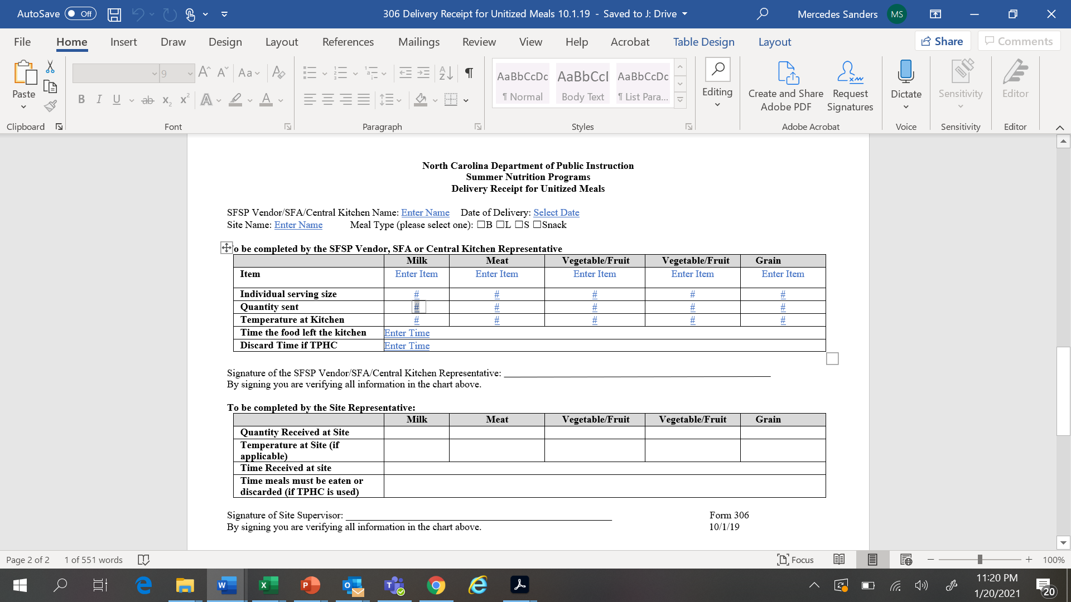
Delivery Receipts
Notes:
Kiona. If you have other delivery receipts you would like to use, please send them to kthomas@foodbankcenc.org for approval. Remember that the site must receive a copy once its signed, and the vendor must be able to keep a signed copy as well. This is mandatory. This documentation will be asked upon monitoring visits and vendor visits. Carbon copies work best. The Food Bank will provide delivery receipts to you via vendor training in May.

Slide 15
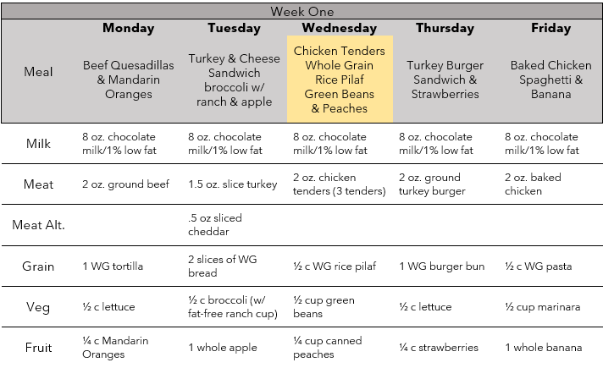
Sample Lunch Menu
Notes:
Chris. Emphasize two week menu required! Once partnership is approved, you will receive other resources on how to create a USDA menu for children. Does anyone have experience with this already?

Slide 16
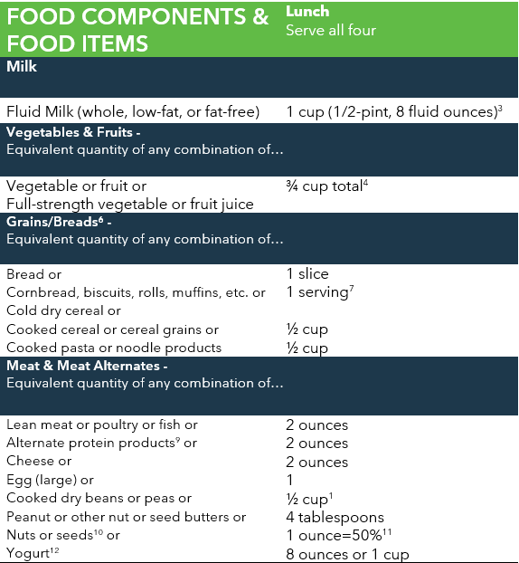
*The milk must be fat-free or low-fat, 1% or 2% milk
Notes:
Chris. It is a USDA recommendation to serve fat-free or low-fat milk.

Slide 17
Meal Pattern Documentation
Child Nutrition (CN) Labels
USDA evaluated and warranty against audits
Only eligible for main dish entrees that contribute ½ oz. equivalent to the MMA component
Product Formulation Statements (PFS)
Comes from manufacturers
Needed for any commercially processed food contributing towards grain and MMA components
Standardized recipes
If you are using a standardized recipes, we ask that a copy of it is submitted prior to partnership
Notes:
Chris

Slide 18
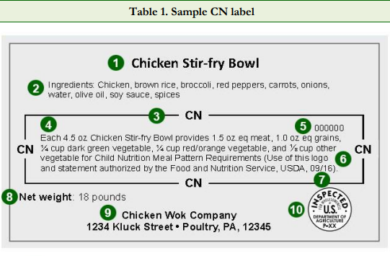
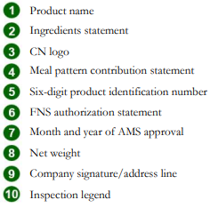
CN Label Example
Notes:
Chris. CN labels are easier to collect and share with the Food Bank

Slide 19
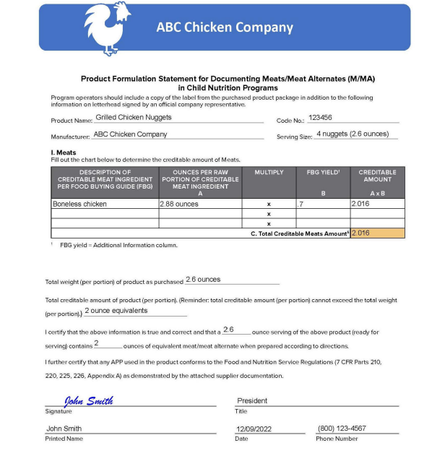








PFS Example
Company Letterhead
Product Name
Code Number
Serving Size
Creditable Ingredients
Weight of Creditable Ingredients
Company rep. Signature
Date
Notes:
Chris

Slide 20
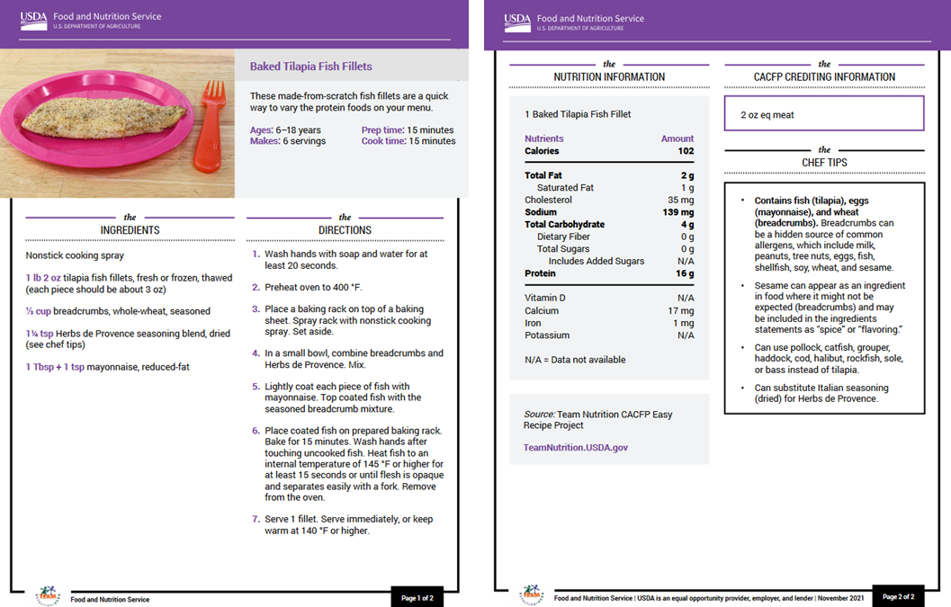
Standardized Recipe Example

Slide 21
2025 Reimbursement Rates
RURAL SITES
Meal Type | Breakfast | Lunch | Snack
Reimbursement Rate | $2.9775 | $5.215 | $1.2350
ALL OTHER SITES
Meal Type | Breakfast | Lunch | Snack
Reimbursement Rate | $2.9225 | $5.13 | $1.2050
Notes:
This is what the Food bank gets paid for these meals. Already a $1 over from the price point we know we will get back. This is why the $7 price point is enforced.

Slide 22

Next Steps
If your catering company or restaurant would like to be a Vendor with the Food Bank for summer 2026, the next step is to email the department to confirm vendor partnership.
Schedule virtual consultation
Notes:
Kiona

Slide 23
Questions?
Christina Paige
Child Nutrition Programs Coordinator
cpaige@foodbankcenc.org
919.695.6914
Thank you for attending!
Notes:
Kiona. First line of contact would be Kiona Thomas. If you cannot get in touch with her, then please contact Chris Lierly.

