Slide 1

Hunger Action Month
Full Plate Circle Kick-off
September 1, 2026
Notes:
ZARRIA
Lorem
Ipsum
Dolor
Sit amet

Slide 2
Our Agenda
Hunger Action Month Overview
State of Hunger in North Carolina
Our Shared Response
Panel Discussion with Partner Leaders
Audience Q&A
Additional Resources
Closing & Action
Need technical support?
Feel free to message Taylor here on Teams – or call (984) 339-1079.
Notes:
Zarria-Our Agenda
We'll kick off with a quick overview of Hunger Action Month
Mariah will share some new data that sheds light on the current State of Hunger in North Carolina
We'll get to hear directly from our Panel of Partner Leaders and what they're facing on the ground
Then we'll open it up to your questions and ideas
We'll close with all the links and resources shared – plus a very quick but impactful action everyone can take in just a minute
If you experience any technical difficulties during the webinar, please reach out to Taylor
She's here in the chat and can also be reached at 984.339.1079

Slide 3
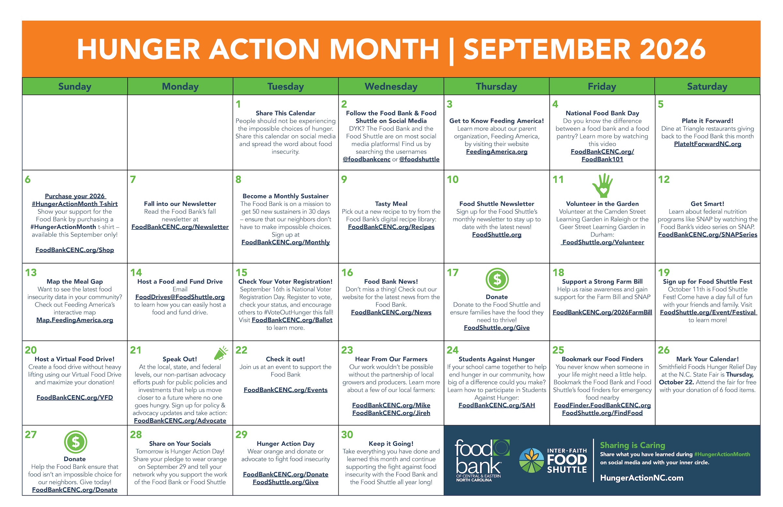
What is Hunger Action Month?
Founded in 2007 to raise awareness and drive action
Celebrated nationwide with opportunities to volunteer, donate, and advocate for change
Includes local efforts like #PlateItForward
Dozens of ways to get involved at HungerActionNC.org!
Notes:
Zarria
September is Hunger Action Month — a time each year when people across the country join together to volunteer, donate and make our voices heard in the fight to end hunger and its root causes.
The event was founded almost 20 years ago (2007) by our national organization, Feeding America, and a host of leading hunger advocacy groups
Throughout September, we hope to raise awareness of the worsening hunger crisis in our region — and encourage action to end food insecurity in our communities.
That includes volunteerism, advocacy, donations of funds and food
And this year we have a new way to get involved — Plate It Forward — where you can dine out at a number of local restaurants and support our work along the way
For folks who are facing challenges, this is a time when we reinforce that that food remains available to all who need it.
And for those of us who are in a position to donate time, energy, or funds, it's never been more important to get involved.
Mariah and our incredible panelists are here to underscore exactly why this work is so important, during hunger action month and beyond
So I'll turn it over to Mariah Murrell, our Chief Community Impact Officer, to ground us in the challenges and opportunities ahead

Slide 4
630,000
Notes:
Mariah
630,000: that's how many of our neighbors are facing hunger across central and eastern North Carolina
This is a huge and disappointing number, to say the least – and we'll dig into how this compares to prior years in just a minute
But I want to pause and let this figure sink in
Because what this means is one out of every seven people we run into at the grocery store, in a waiting room, or out on a walk in our neighborhood face hunger

Slide 5
State of Hunger in Our Region
2021 DATA | 2024 DATA*
450,120 people 1 in 9 individuals | 629,980 people 1 in 7 individuals
134,560 kids and teens | 191,220 kids and teens
*most recent data available; described as "current state"
Notes:
Mariah
These statistics are a product of Census Bureau data (through the regular American Community Survey) combined with USDA analysis.
You may have heard that the USDA no longer intends to provide this analysis moving forward, so this may be the last comprehensive look we have for some time.
There's about an 18-month span between when surveys are conducted on the ground and when the results are compiled and analysis is ready to share
That means when we talk about "present day" or "current state of" hunger from a statistical perspective, it's actually the snapshot as of December 31, 2024
Given the economic challenges we're all facing right now, we've found that the most relevant comparison is to the peak of the pandemic in 2021
So many of us lost income, jobs, homes, and loved ones at that time – and we all know it was a period of real economic disruption and uncertainty
But despite all those losses and challenges, there are actually ~180,000 *more* people facing hunger today than the pandemic's peak
We were full-court-press in 2021, with significant federal resources invested in keeping hunger in check
We removed red tape for seniors and people with disabilities to receive food assistance
We made school meals available at no cost to any child who needed it
We offered direct support to families who were struggling, putting tax credits to work in real-time that otherwise wouldn't have arrived for a year or more
And it worked! We cut child poverty in half. We kept food insecurity from spiraling out of control.
But once the public health emergency ended, we pretended that the economic emergency was also over
We now knew what worked in reducing hunger, but pulled back all those supports anyhow
And we've seen the numbers of people facing food insecurity grow every year since, here in our region and across the country
As federal support for families and farms gets scaled back further and further, hunger grows wider and wider
Now hunger has reached 1 in 7 of us, up from 1 in 9
And based on our experience on the ground, we expect this would be even more common if we surveyed the public today in August 2026
2021: 450,120 people were food insecure
1 in 9 (11%) people face food insecurity
1 in 7 (15%) kids and teens
1 in 5 (21%) in Black households
1 in 6 (17%) in Latinx / Hispanic households
1 in 13 (8%) in White households
2024: 629,980 people are food insecure in our region.
1 in 7 (14.8%) individuals
1 in 5 (20.6%) kids and teens
1 in 3 (30%) in Black households
1 in 4 (23%) in Latinx / Hispanic households
1 in 9 (11%) in White households

Slide 6
State of Hunger in Our Region
2021 DATA | 2024 DATA*
450,120 people 1 in 9 individuals | 629,980 people 1 in 7 individuals
134,560 kids and teens | 191,220 kids and teens
21% of Black households | 30% of Black households
17% of Latine households | 23% of Latine households
8% of White households | 11% of White households
*most recent data available; described as "current state"
Notes:
Mariah
So we know that hunger's reach has widened to touch more lives than any time in recent memory
But unfortunately that's not the whole story
Hunger has also grown deeper in specific communities, many of which have faced barriers and exclusion for generations
Here in the south, these disparities are most prominent when we look at hunger statistics across race
More people are facing hunger across the board
But hunger is an even greater challenge in Black and Latine households
To the extent where we now see 2-3 times the rate of hunger when compared to White households
We all live in the south, so we're likely more familiar with the root causes of these disparities than folks who live elsewhere – because we've experienced it first hand
But we can see from these numbers that the barriers and exclusions that have existed for many generations are very much playing out today, and it's getting worse each year
We see similar disparities playing out in other communities as well – among Native Americans and First Nations, among households with young children, even among veterans and active duty military families
In many areas, 1 out of every 4 or even 1 in 3 of these households struggle to keep food on the table today
That's 25-35% of people who don't know where there next meal might come from in any given month
So when you hear the Food Bank network talk about matching our solutions with the depth of the challenge, this is what we mean
More support is needed across the board – and we also know that more significant action is needed where hunger is at its worst
The stats here are for our 34-county service area only — there are even greater challenges when we look at the whole state
2021: 450,120 people were food insecure
1 in 9 (11%) people face food insecurity
1 in 7 (15%) kids and teens
1 in 5 (21%) in Black households
1 in 6 (17%) in Latinx / Hispanic households
1 in 13 (8%) in White households
2024: 629,980 people are food insecure in our region.
1 in 7 (14.8%) individuals
1 in 5 (20.6%) kids and teens
1 in 3 (30%) in Black households
1 in 4 (23%) in Latinx / Hispanic households
1 in 9 (11%) in White households

Slide 7
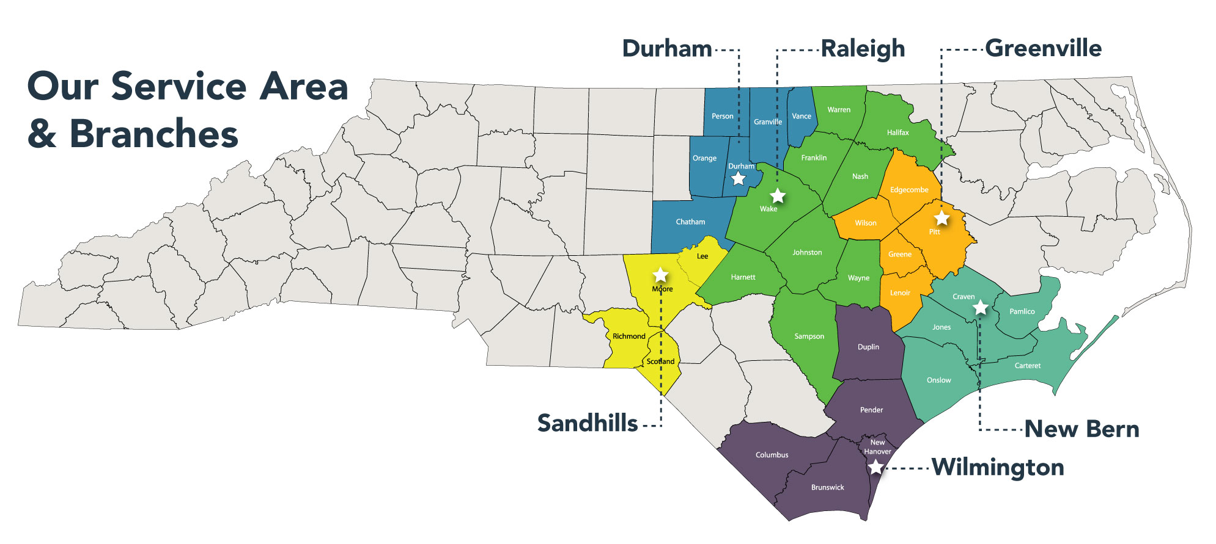
630,000 people facing hunger
700 partner programs
180 staff across six branches
Notes:
Mariah
Now that we have a sense of the scope of this crisis, let's talk about our shared response
700+ partner programs
180+ staff across six branches
$44+ million cash operating budget
That funding nets more than $250 million in food and essential supplies that flow through our distribution centers each year
So when we talk about your dollars going further with the Food Bank network, this is exactly what we mean
For every dollar donated, we can provide enough food to fuel three meals in the community
97% of donations go to these programs and services; with 2% fundraising activities and 1% to administration

Slide 8
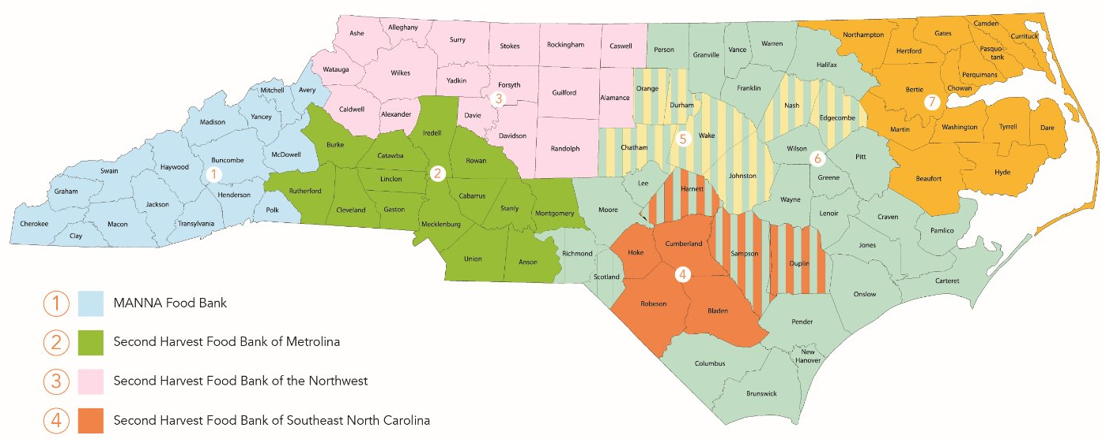
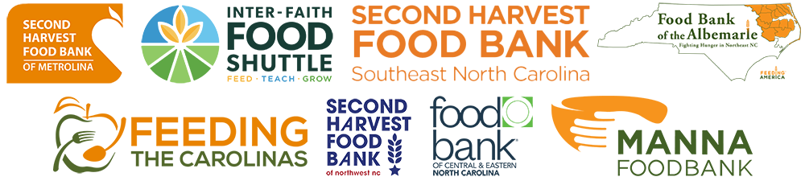
Notes:
Mariah
It'smportant to note that none of our work would be possible without coordination and support across our state association
We work every day with our six sister food banks, each covering a large geographic area
You'll also see some overlapping colors here – and that's because we collaborate closely with our neighboring food banks based in Fayetteville, Raleigh, and Elizabeth City
We work together to source more food at scale and to deliver products as efficiently as possible to local partners like those you'll hear from today
Together, we cover about half of the state's counties and population

Slide 9
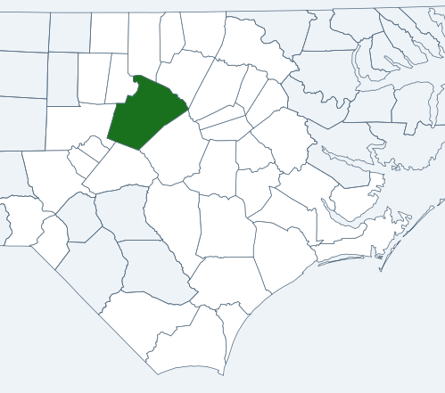
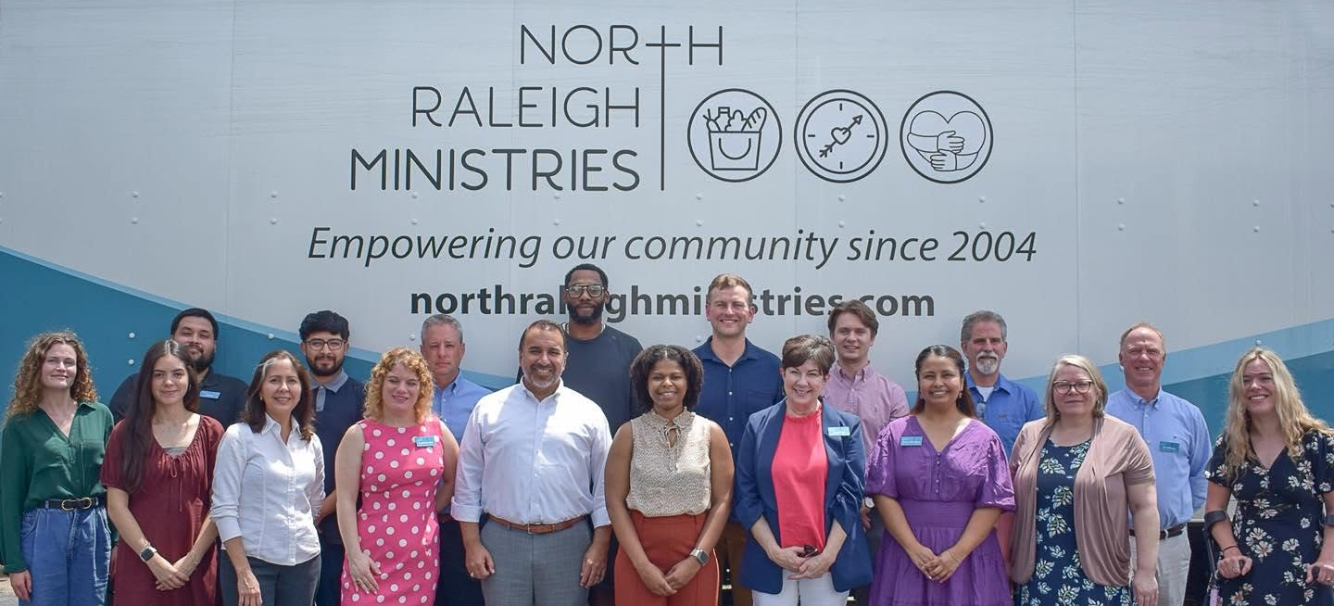
North Raleigh Ministries: Marco Ramirez
Facilities in Raleigh
Serving North Raleigh area
4,500+ households
served last year
160,000+ meals
provided annually
Notes:
Mariah
I want to take a moment to introduce each of our speakers before we turn it over to Zarria to lead our conversation
My team has the privilege of working with these incredible leaders every day, and we're grateful to have them with us
First is Marco Ramirez of North Raleigh Ministries, one of our key partners in Wake County
North Raleigh is an incredible example of an agency that provides true "wraparound services" — from their on-site market and drive-through food distribution, to financial and family counseling, to ongoing peer support and pastoral care
Last year, they served more than 4,500 households from the North Raleigh zip codes and beyond – including enough food to fuel more than 160,000 meals

Slide 10
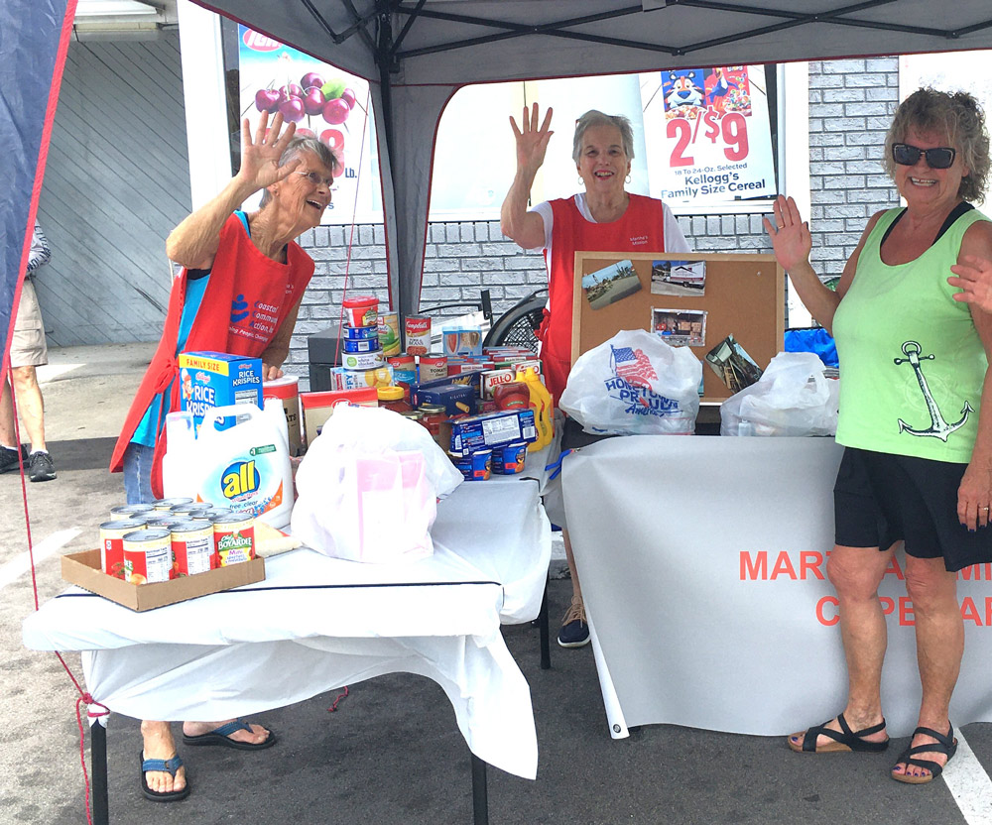
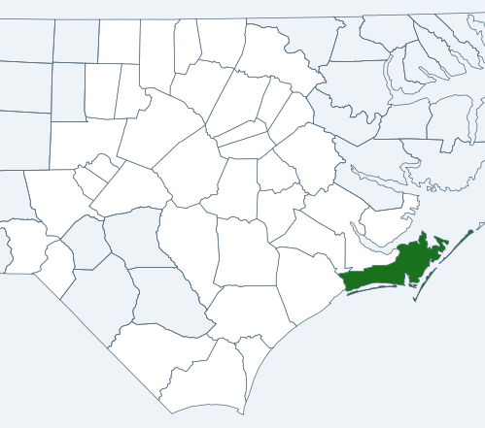
Martha’s Mission: Mary Schronce
Based in Morehead City
Serving Carteret County
4,400+ households
served annually
Fresh produce for
166,000+ meals each year
Notes:
Mariah
Mary Schronce leads Martha's Mission Cupboard in Morehead City
Martha's Mission is an all-volunteer organization, fueled by close to 6,000 volunteer hours each year
That crew is doing amazing work serving more than 4,400 households in 2025 alone
Of particular note is their focus on fresh fruits and vegetables
They provided enough produce to fuel 160,000+ meals last year!

Slide 11
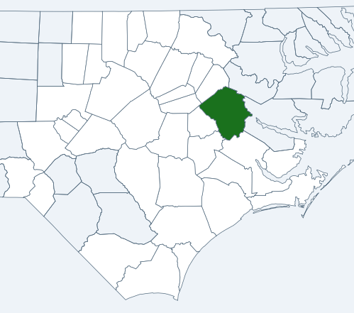
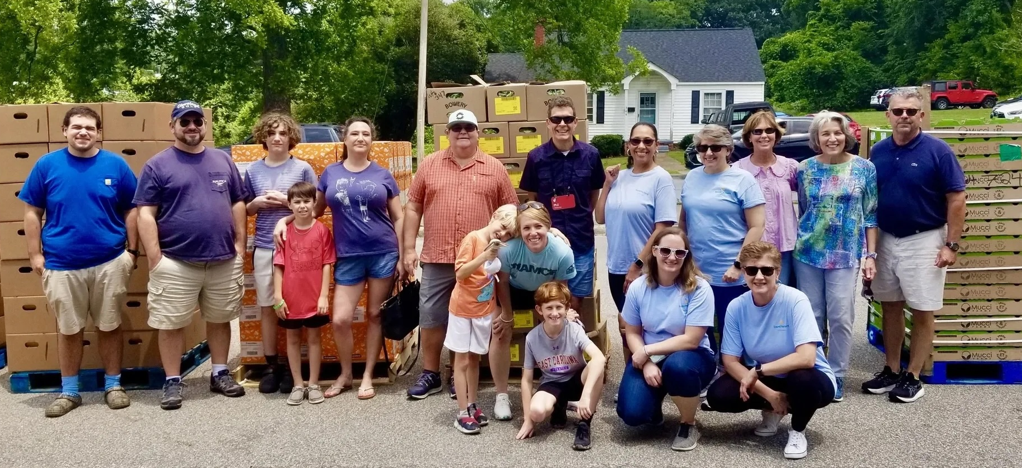
Feed Your Neighbor: Whykeshia White
Based in Greenville
Serving Pitt County
Supporting 700+ households monthly
200,000+ meals provided
Notes:
Mariah
And Whykeshia White is the new Executive Director of Feed Your Neighbor Community Food Pantry
Some of you may know Whykeshia from her time as a leader here at the Food Bank, and we're excited to have her at the helm of a great partner agency in Greenville
Feed Your Neighbor is relatively new as a formal nonprofit, they've been a pillar of the community for more than 20 years
In that time, they've grown to support 700+ households each month – providing more than 200,000 meals in the Greenville area over the past year

Slide 12
Tell us a bit about your organization — your mission, scope, and programs you offer to the community?
DISCUSSION:
Notes:
Zarria
We always say at the Food Bank that we cannot do this work without our strong partner network — and we are so excited to have this opportunity for you to share with supporters. Can you each tell us a little about your agency including overall mission/scope and any programs you offer to the community?

Slide 13
What are you seeing today? How does that compare to prior years? What changes are you making to meet the moment?
DISCUSSION:
Notes:
Zarria
Those of us on the front lines don’t need federal surveys to tell us how significant hunger has become in our communities – we experience those challenges first-hand every day. Still, the annual report validates what so many of our partners are seeing day to day. I’d love for you to share a bit about what you’re seeing today, how that compares to prior years, and what changes you may be making to meet the moment. (Potential responses on increased need, references to inflation and high costs of housing, healthcare, fuel, food, etc.,)

Slide 14
How can our community take action in ways that are most impactful to you, during September and beyond?
DISCUSSION:
Notes:
Zarria
I’d like to pose this question to our expert panelists and also to Mariah to share the Food Bank’s perspective: Hunger Action Month is just that – a month of dedicated attention and action. But we all know that hunger exists year-round. We have some of our most dedicated supporters gathered with us today. How can this community take action in ways that are most impactful to your organization, during September and beyond?

Slide 15
Any final thoughts to leave with our supporter community?
DISCUSSION:
Notes:
Zarria
Thank you all so much for everything you’ve shared with us today. We truly couldn’t do this work without you – and the experiences you’ve brought to this group have been eye-opening. We’re going to open up to everyone shortly for questions, but I’d love for each of you to share a final thought to leave with our supporter community. Mariah, if you would please share as well.

Slide 16
Q&A
We welcome your questions and ideas!
Notes:
With the time we have left together, we'd love to open it up to all of you
What questions do you have? Thoughts or ideas?
Whether it's specific to one panelist or for the group, we want to hear from you!

Slide 17

Make A Difference in Two Minutes!
Urge elected leaders to protect SNAP grocery support.
Notes:
Zarria
We'll close out here with two quick slides:
First is an opportunity to take meaningful action now
As you learned today, our panelists are moving mountains to meet this hunger crisis head on
And we know we can't succeed without strong partners in government
That's why protecting SNAP grocery support is so important – and major decisions are coming up between now and the end of the year in DC
So if you open up the camera on your phone and scan the code on screen, you'll see a very brief form
All you need to do is enter your home info; we want to make sure the message reaches representatives where you vote and live
It just takes two minutes to send a message – you can customize if you'd like, or leave the template as-is
We know congress and our state legislators need to hear from us that SNAP is too important to our community

Slide 18
Resources
Partner Support
Feed Your Neighbor Community Pantry (Pitt County)
Martha's Mission Cupboard (Carteret County)
North Raleigh Ministries (Wake County)
Info & Action
Hunger & Impact Map
Hunger Action Month (all avenues)
Plate It Forward (dine out to support our work!)
Notes:
Zarria
And last, I want to make sure you have all the links we promised to learn more about our incredible panelists and their work
We'll drop in the data map and September opportunities here – and you can expect these by email afterward as well
Taylor to add to the chat for folks to access links:
Feed Your Neighbor (Whykeshia/Greenville): https://www.feedyourneighborgreenville.org/
Martha's Mission Cupboard (Mary/Morehead City): https://marthasmission.com/
North Raleigh Ministries (Marco/Raleigh): https://northraleighministries.com/
New hunger data and impact map: https://foodbankcenc.org/hunger-impact
Hunger Action Month 2026: https://hungeractionnc.org
Plate It Forward 2026: https://plateitforwardnc.org

Slide 19
Thank You!
Notes:
With the time we have left together, we'd love to open it up to all of you
What questions do you have? Thoughts or ideas?
Whether it's specific to one panelist or for the group, we want to hear from you!

